Slide 1

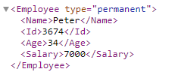
XML Elements are Extensible
XML elements can be extended to carry more information.
Let's assume that we created an application that extracted the <Name>, <Id>, and <Age> elements from the XML document to produce the output in GUI
UI
Name : Peter
Id : 3674
Age : 34
Assume that the author of the XML document added some extra information(Salary) to it
Should the application break or crash?
No. The application should still be able to find the < Name >, < Id >, and < Age > elements in the XML document and produce the same output. So XML can be extended without breaking applications.

